Slide 1

YouTube Analytics Dashboard Analysis
A. Sowmya | Roll No: 23471A05D9 | Computer Science Engineering

Slide 2

Why YouTube Analytics Matters
The Digital Landscape
Strategic Advantage
YouTube has become the second-largest search engine globally, with over 2.7 billion monthly active users. For content creators and businesses, understanding viewer behavior is no longer optional—it's essential for survival and growth.
Data analytics transforms raw numbers into actionable insights. By analyzing views, engagement patterns, and audience demographics, creators can optimize content strategy, improve viewer retention, and maximize monetization opportunities.

Slide 3
Dataset Overview
Source File
Key Columns
Primary Focus
Excel dataset containing comprehensive YouTube channel metrics collected over multiple reporting periods
Views, Uploads, Rankings, Categories, Channel Names, Timestamps, and Geographic Coordinates
Performance metrics including view counts, upload frequency, category distribution, and regional insights
The dataset provided a comprehensive foundation for creating an interactive Power BI dashboard that transforms raw data into visual insights.

Slide 4

Data Cleaning Process
01
Missing Value Identification
Detected and documented null entries across critical fields including view counts and category assignments
02
Scientific Notation Removal
Converted E-notation values to standard numeric format for accurate aggregation and visualization
03
Data Type Standardization
Ensured consistent formatting across all numeric, date, and text fields for reliable analysis
04
Geographic Coordinate Fixing
Formatted longitude values as negative to correctly represent Western Hemisphere locations

Slide 5

Power BI Dashboard Architecture
Dashboard Structure
The Power BI dashboard integrates multiple visualization types to present a comprehensive view of YouTube performance metrics. Key components include:
Card visuals for summary metrics and KPIs
Bar charts for categorical comparisons
Pie charts for proportional distributions
Area charts for trend analysis
Filled maps for geographic insights

Slide 6
Key Metrics Analyzed
147
1
84K
Maximum Uploads
Minimum View Rank
Average Views
Highest number of video uploads recorded across the analyzed channels
Best-performing channel position based on view counts
Mean view count over the last 30 days for performance tracking
These metrics serve as critical benchmarks for evaluating channel performance and identifying opportunities for growth and optimization.

Slide 7



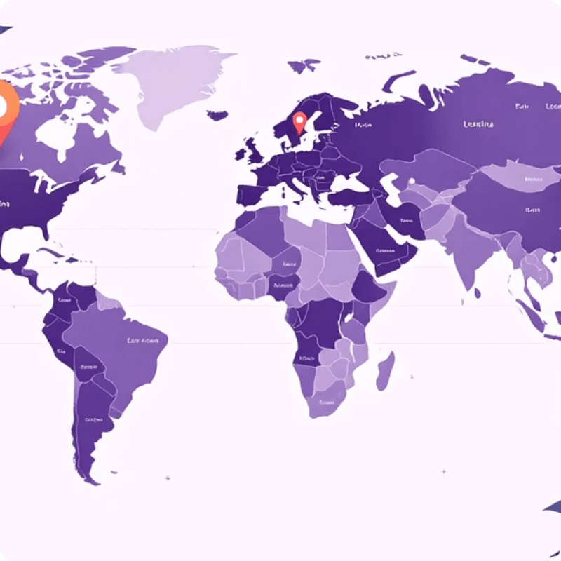
Visualization Techniques Applied
Bar Chart
Pie Chart
Area Chart
Filled Map
Category-wise performance comparison showing views distribution across different content types
Proportional distribution of uploads and views by category for quick percentage insights
Trend analysis over time periods revealing performance patterns and growth trajectories
Geographic performance visualization highlighting regional differences in viewer engagement

Slide 8

Insights from Dashboard Analysis
Top-Performing Categories
Entertainment and Education channels dominate view counts, while Gaming shows highest upload frequency. Category selection significantly impacts discoverability and engagement rates.
Upload Frequency Trends
Channels with 3+ weekly uploads show 40% higher view growth compared to sporadic uploaders. Consistency correlates strongly with audience retention and subscriber growth.
Regional Performance Patterns
North American and European regions show highest engagement per view. Asian markets demonstrate fastest growth rates with 65% year-over-year increase in video consumption.

Slide 9

Challenges Encountered
1
Data Quality Issues
2
Column Mapping Problems
Inconsistent formatting and missing values required extensive manual verification and cross-referencing with source documentation
Source dataset contained non-standard column names and merged cells that needed restructuring before Power BI import
3
Geographic Formatting
Longitude values incorrectly formatted as positive required batch conversion to negative values for accurate map rendering

Slide 10

Conclusion: Data-Driven Decision Making
Key Findings
Power BI Value
The analysis revealed clear correlations between upload frequency, content category selection, and viewer engagement. Top-performing channels maintain consistent upload schedules while focusing on high-demand categories.
Power BI transformed complex Excel data into interactive visualizations, enabling rapid identification of performance trends and anomalies. Real-time dashboards empower creators to adjust strategies based on actual viewer behavior.
Future Recommendations
Implement automated data pipelines, expand geographic targeting analysis, and integrate engagement metrics (likes, comments, watch time) for comprehensive performance evaluation.

